Slide 1


Bank Loan Prediction Model
Athira John & Mukta Pathak
ADMN-5016-101

Slide 2
Table of contents
01
02
03
04
Exploratory Data Analysis
Data Preprocessing
Descriptive statistics, Imbalance in data, Correlation analysis
Handling outliers, Missing values, Clustering, Normalization of features
Model Development
Model Comparison
Data splitting, Random Forest Model, Logistic Regresssion Model, Hyperparameter tuning
ROC curve

Slide 3

01
Exploratory Data Analysis

Slide 4
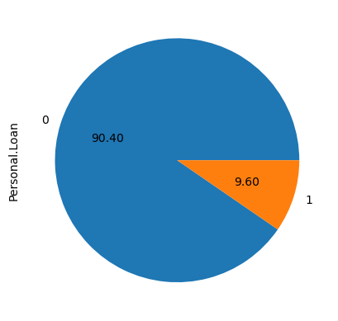
Imbalance in Data
Not Approved (0): 4520 cases
Loan Approved (1): 480 cases

Slide 5
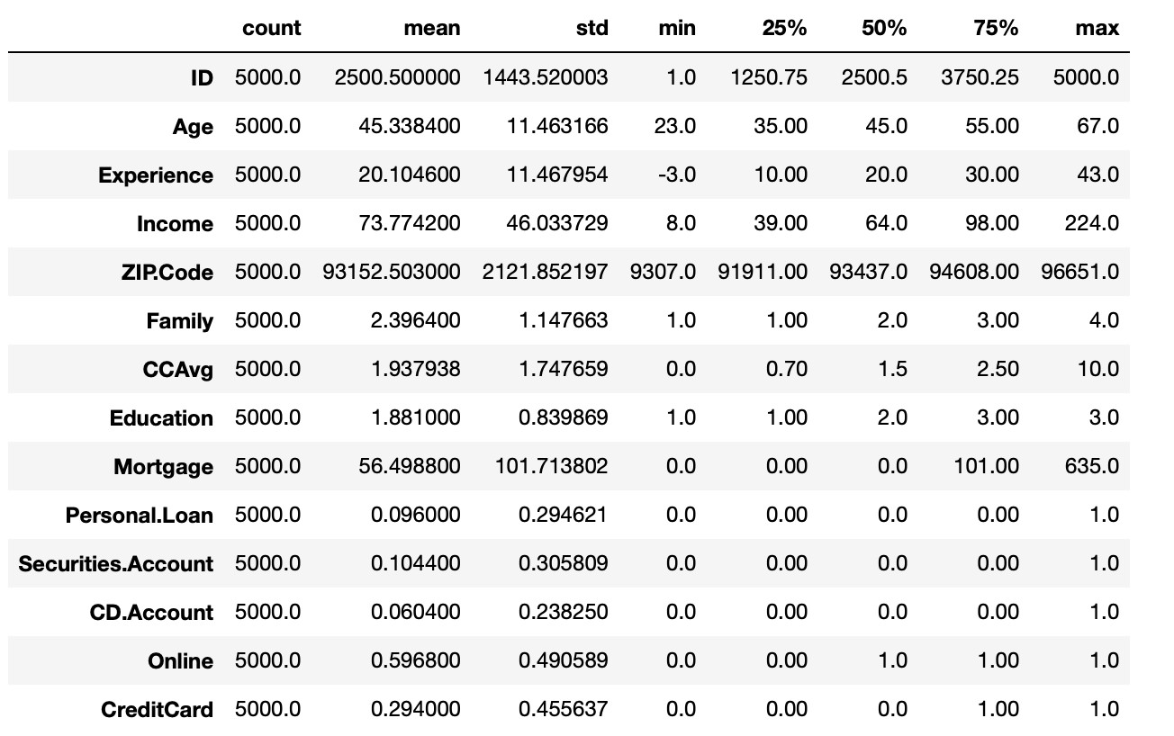
Descriptive Statistics
Descriptive statistics helps to understand the distribution, central tendency, and variability of each variable.

Slide 6
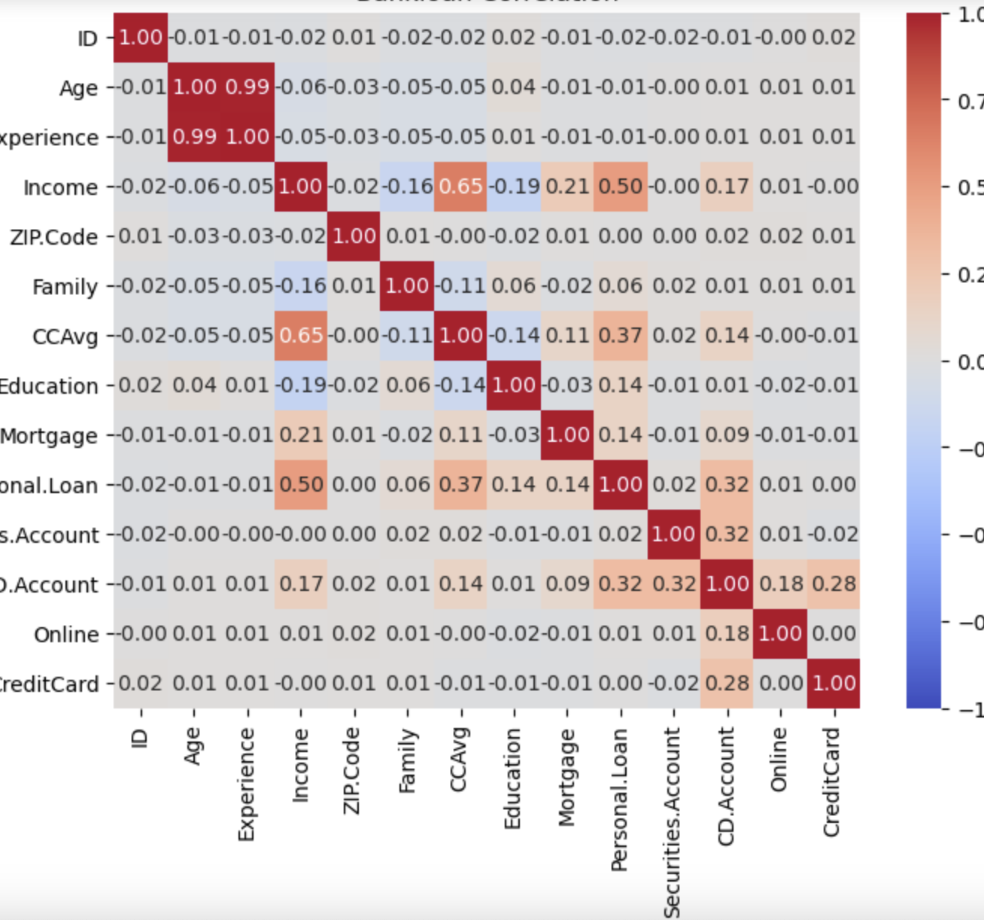
Correlation Analysis
The correlation matrix provides insights into the relationships between various features in the dataset. Some key observations include a strong positive correlation of approximately 0.99 between 'Age' and 'Experience,' indicating a natural association between age and professional experience. 'Income' exhibits a moderate positive correlation of around 0.65 with 'CCAvg' and 'Mortgage,' suggesting that individuals with higher incomes tend to have higher average credit card spending and mortgage amounts.

Slide 7

02
Data Preprocessing

Slide 8
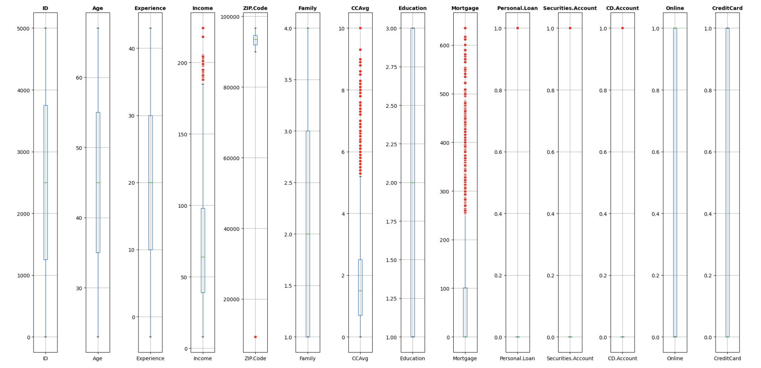
Outliers
People with high income are outliers in the data set. CCAvg and Mortgage values also contains outliers. Since these values are significant, we cannot simply remove them.

Slide 9


Missing Values
The dataset exhibits a reassuring absence of missing values across all columns.

Slide 10
Clustering
Without Outliers
Outliers
This group contains the people with income which are not outliers.
This group contains people with high income ,who were outliers.

Slide 11

Feature Scaling
Feature scaling is a pre-processing step in machine learning that involves transforming the values of your features (variables) so that they fall within a similar scale.
We used standardization in our data set because most of the variables are binary except Income, CCAvg and Mortgage.

Slide 12
03
Model Development

Slide 13
Data Spliting
Training Set
Testing Set
80%
20%

Slide 14
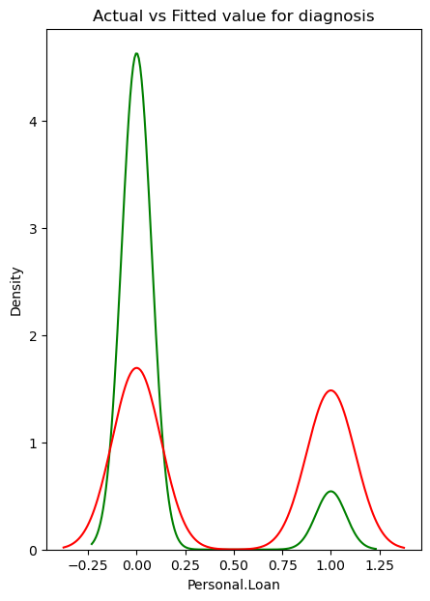
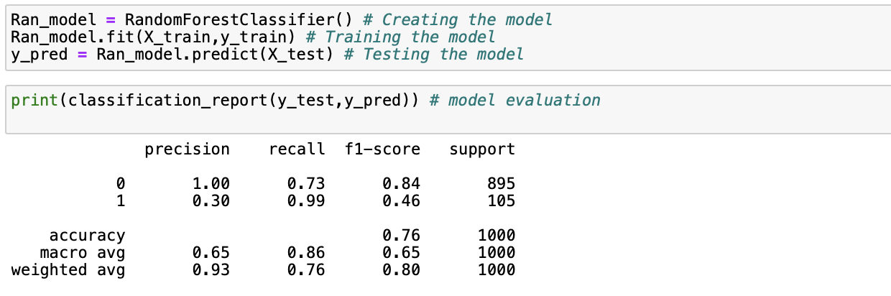
Random Forest Model
Cluster 1: Without outliers
Trained and tested a random forest model on the same dataset, resulting in an accuracy of 96.64%.

Slide 15

Hyper Parameter Tuning
The hyper-tuned Random Forest model exhibits a notable improvement, with an enhanced accuracy of 91.33% after 10-fold cross-validation. The refined model demonstrates improved precision and recall, particularly in correctly identifying instances of "1" (indicating acceptance of a personal loan), achieving a more balanced and reliable predictive performance.

Slide 16
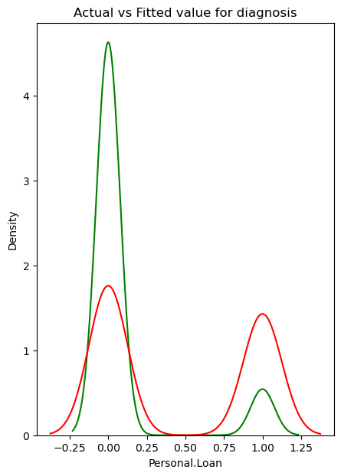
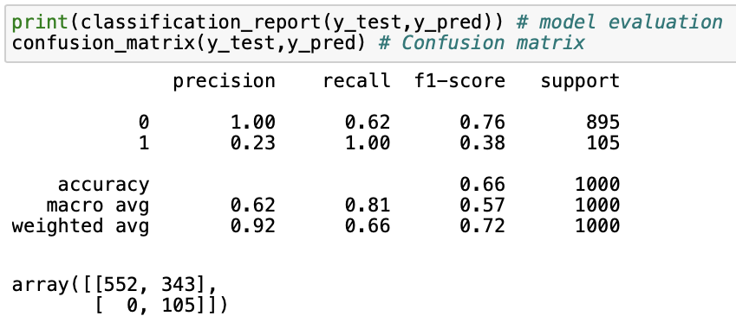
Logistic Regression Model
Cluster 1: Without outliers
Trained and tested a logistic regression model on the same dataset, resulting in an accuracy of 88.67%.

Slide 17
Random Forest Model
Cluster 2: outliers
Accuracy: The random forest model exhibited superior performance with a 96% accuracy, showcasing its effectiveness in handling outliers.
Precision, Recall, F1-score: Precision and recall scores above 95% emphasize the model's proficiency in correctly classifying instances.
Cross-validation: The 96.03% mean accuracy in cross-validation indicates consistent performance.

Slide 18
Logistic Regression Model
Cluster 2: Outliers
Accuracy: The model achieved an accuracy of 93%, indicating its ability to correctly classify instances.
Precision, Recall, F1-score: With precision and recall both exceeding 90%, the model demonstrates a good balance between identifying positive instances and avoiding false positives.
Cross-validation: The 88.33% mean accuracy across 10-fold cross-validation ensures robustness.

Slide 19
04
Model Comparison

Slide 20
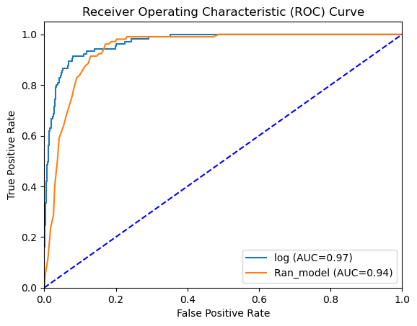
ROC Curve
The Random Forest model exhibited a higher AUC, indicating superior discriminatory power. The ROC AUC values indicate that the logistic regression model achieved a higher area under the curve (0.97) compared to the random forest model (0.94), suggesting better overall discrimination and balance between true positive rate and false positive rate for the logistic regression model.

Slide 21

Key Learning
Data Understanding: Comprehensive understanding of dataset and problem context is essential.
Handling Imbalanced Data: Employ techniques like random under sampling for balanced representation.
Model Evaluation Metrics: Choose metrics like precision, recall, and F1-score for bank loan scenarios.
Balancing Interpretability and Performance: Balance interpretability and performance; logistic regression vs. random forest.
Hyperparameter Tuning: Use hyperparameter tuning (e.g., random search) for optimal model settings.
Continuous Model Improvement: Regularly monitor and update models based on changing data patterns.
Ethical Considerations: Address biases and ethical considerations for fair and responsible use.

Slide 22

Thank You

